Slide 1

FACIAL EMOTION, AGE, GENDER, FACE DETECTION USING WIDE RESIDUAL ARCHITECTURE
Batch number : C16
Guide name : Mr.D. Elangovan, M.E.,
Associate Professor, Department of CSE,
Panimalar Engineering College.
Team Members : Tirupati Kiran Raj [211418104295]
Vaddi Jaswanth Reddy [211418104298]
Kanala Aravind [211418104109]

Slide 2
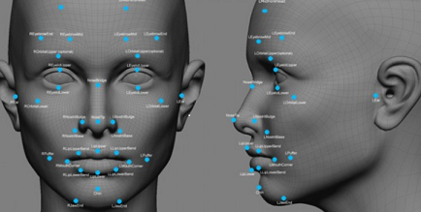
INTRODUCTION :
Automatic emotion recognition based on facial expression is an interesting research field, which has been presented and applied in several areas such as safety, health, and human-machine interfaces
Various techniques to interpret, code facial expressions and extract these features are being developed in order to have a better prediction, with high accuracy and precision by the computer.
Quick and accurate emotion recognition may increase the possibilities of computers, robots, and integrated environments to recognize human emotions, and respond accordingly to the social rules.
The state-of-the-art techniques are only capable of detecting age, gender, and face behavior. New techniques are required for the accurate estimation of human facial emotions.
We cover deep learning-based Wide Resonant Architecture to analyze granular level emotional changes.

Slide 3
LITERATURE SURVEY
AUTHOR NAME | PAPER NAME | DECSRIPTION
Pradnya Kedari, Mihir Kapile, Sagar Jaikar | Face Emotion Detection Using Deep Learning | Using deep learning algorithm to identify the basic human emotions (e.g., anger, fear, neutral, happy, sad, surprise,etc.) on multiple datasets, including FER-2013
Shan Li and Weihong Deng | Deep Facial Expression Recognition | Deep neural networks have increasingly been leveraged to learn discriminative representations for automatic FER. Recent deep FER systems generally focus on two important issues: overfitting caused by a lack of sufficient training data and expression-unrelated variations
Ji-hae Kim, Byung-gyu Kim | Efficient Facial Expression Recognition Algorithm Based on Hierarchical Deep Neural Network Structure | The appearance feature-based network extracts the holistic feature of the LBP feature containing the information. The geometric feature-based network extracts the dynamic feature
Catherine Marechal, Dariusz Mikołajewski | Survey on AI-Based Multimodal Methods for Emotion Detection | A novel multimodal implicit emotion recognition system can be built upon an AI-based model designed to extract information on the emotion from different devices.

Slide 4

PROBLEM STATEMENT
Non-verbal communication methods such as facial expressions, eye movement, and gestures are used in many applications of human-computer interaction.
Numerous studies have been conducted on automatic facial expression analysis because of its practical importance in sociable robotics, medical treatment, driver fatigue surveillance, and many other human-computer interaction systems.
In order to create computer modeling of humans’ age, gender, and emotions plenty of research has been accomplished. But it is still far behind the human vision system.
Thus, we propose a system that uses algorithms to detect unique facial features and proportions to accurately identify users, detect age, gender, and facial emotions using deep learning.

Slide 5


DEVELOPMENT ENVIRONMENT
Hardware and Software Requirements ::
Language - Python
OS : Windows 7 or above.
Ram - 4gb or above
Tools - Anaconda, VS code.
Processor of frequency 1.5GHz or above.

Slide 6
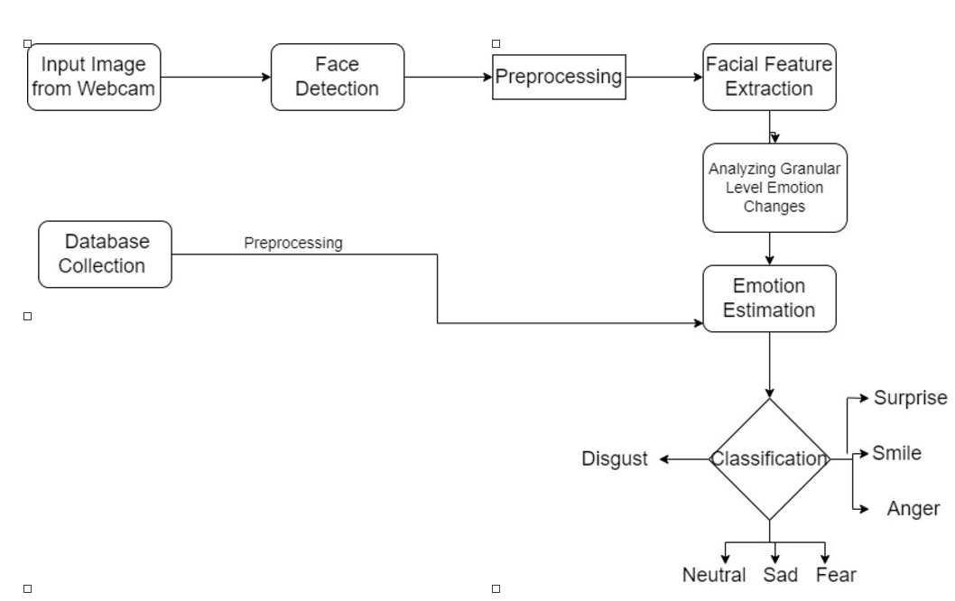
ARCHITECTURE DIAGRAM

Slide 7
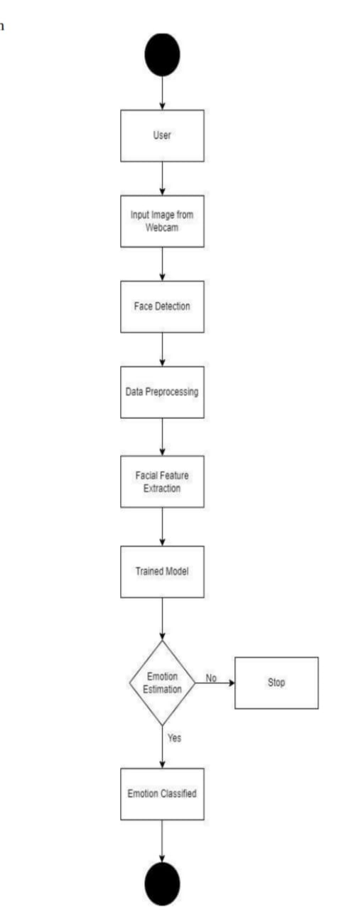
ACTIVITY DIAGRAM

Slide 8
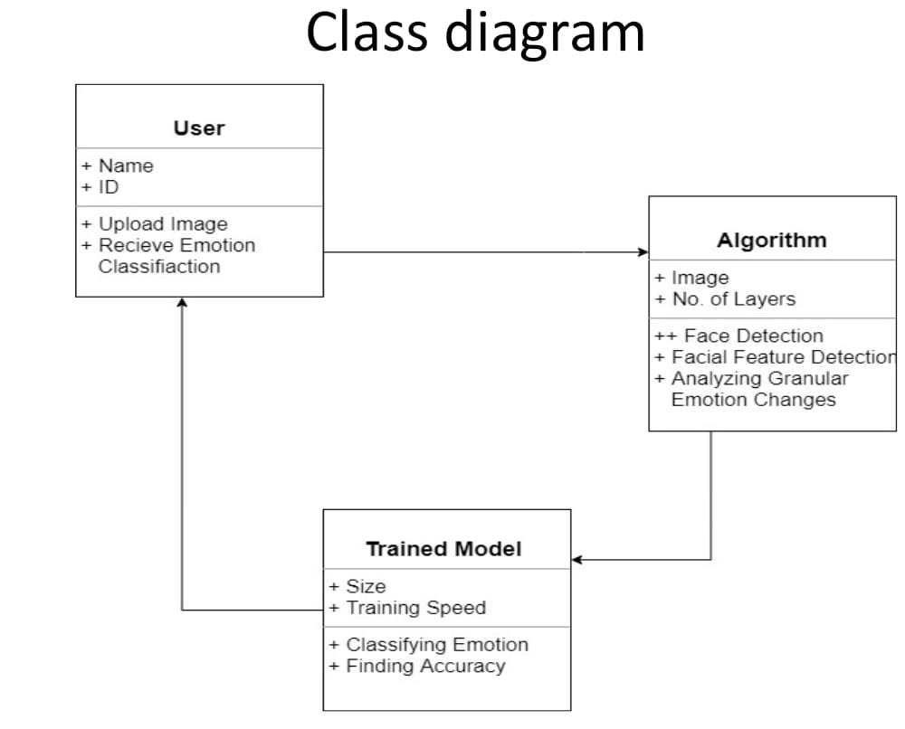
CLASS DIAGRAM

Slide 9
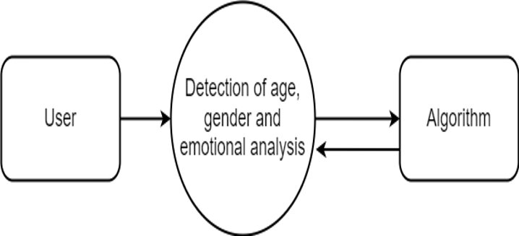
DFD (LEVEL 0)

Slide 10
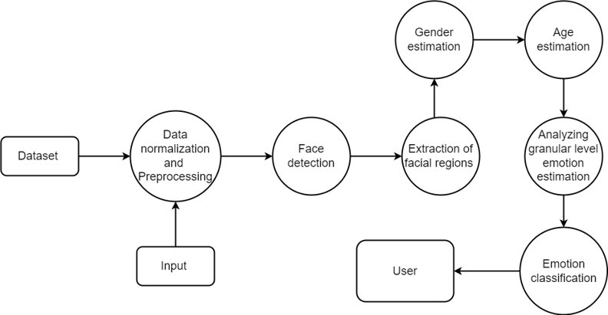
DFD (LEVEL 1)

Slide 11
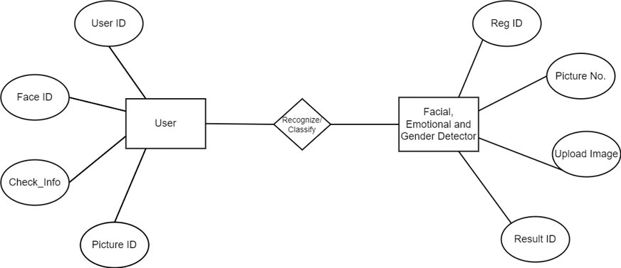
ER DIAGRAM

Slide 12
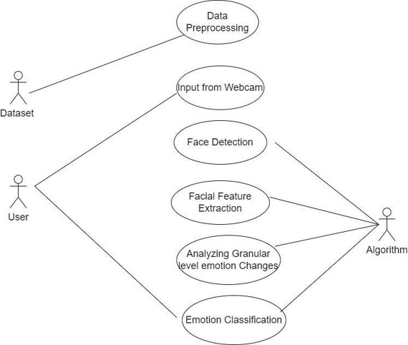
USE CASE DIAGRAM

Slide 13
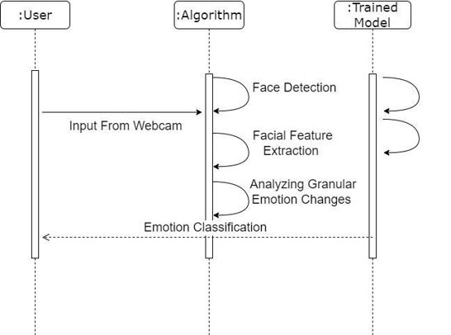
SEQUENCE DIAGRAM

Slide 14
MODULES
LIST OF MAIN MODULES
Module 1: Face Detection​
Module 2: Gender Detection​
Module 3: Age Detection​
Module 4: Emotion Estimation

Slide 15
MODULE DESCRIPTION
MODULE 1: Face Detection
The process of searching for faces is called face detection. In real-time, searching for face in the sequential images containing face and background is seen as the first step of the systems, and the corresponding tasks of face analysis are implemented. Face detection is to search for faces with different expressions, sizes and angles in images in possession of complicated light and background, and then feedback parameters of the face.

Slide 16
MODULE DESCRIPTION
MODULE 2: Gender Detection
There are some common features in the human face that identify male and female. The first component of the proposed architecture deals with gender estimation from face images. ​
One major issue in gender estimation is how to extract effective representation features from a facial image. To achieve this, face detection and pose estimation methods are adopted to acquire frontal face images. I have used advanced machine learning techniques to provide gender classification. The gender estimation process consists of three steps: Detection and extraction of the facial region from the input image/video. selection of the frontal face images from the, extracted facial regions using head pose estimation, and gender estimation using statistical facial features. The features extracted from the face image are used to estimate the gender of the recipient.

Slide 17
MODULE DESCRIPTION
MODULE 3: Age Detection
Human features are very sensitive to texture and skin tone, and most of the selected features are located around the meaningful areas for recognition, such as eyebrows, nose, cheekbones, and jaw-line. Automated age estimation of the human face involves detecting, tracking, and normalizing the face in an image sequence. After the face and eyes are detected, the facial image can be normalized as a fixed-size image using the localized eye positions.​
This module features features such as the location of the pupils, eye corners, lip boundaries, etc. This is because these features are bound to change with age. This algorithm is trained on a large data set of different faces to detect the approximate age of a person based on such features. The accuracy of the prediction depends on conditions such as lighting, head pose, etc.

Slide 18
MODULE DESCRIPTION
MODULE 4: Emotion Estimation
Facial emotion recognition refers to the separation of specific facial states from a given static image or dynamic video sequence, so as to determine the psychological emotions of the object to be recognized. Facial emotions can be divided into seven categories: happy, sad, fearful, angry, surprised, disgusted, and neutral. The first thing to do for facial expression recognition is to preprocess the collected images, and then carry out feature extraction and classification recognition. ​
The third component, Emotion estimation, detects facial expressions from images or videos and returns the probability distribution of each of the universal emotions: happiness, sadness, anger, fear, surprise, disgust, and additionally neutral. Automatic facial expression analysis of one or multiple faces in real-time can also be performed.

Slide 19
TESTING
TEST NO. | INPUT | EXPECTED BEHAVIOUR | TESTING | STATUS
1 | User uploading video as an input | Video file updated | Unit Testing | Pass
2 | User uploading image an input | File not accepted because only video inputs | Unit Testing | Fail
3 | Capturing face in video | Age, gender, emotion, face emotion prediction | Output Testing | Pass
4 | Capturing other objects in video | Age, gender, emotion , face recognition not detected | Output Testing | Fail

Slide 20
CONCLUSION
Emotion is an important topic in different fields such as biomedical engineering, psychology, neuroscience, and health. Emotion recognition could be useful for the diagnosis of brain and psychological disorders.
Human faces are different for different people on the basis of various parameters. The uniqueness and measurement of the different parameters help us to detect the age, gender, and emotional behavior of the person.
Our proposed model for face recognition and pose estimation system is beneficial to the world for advanced applications such as access and security, payments, criminal identifications.

Slide 21
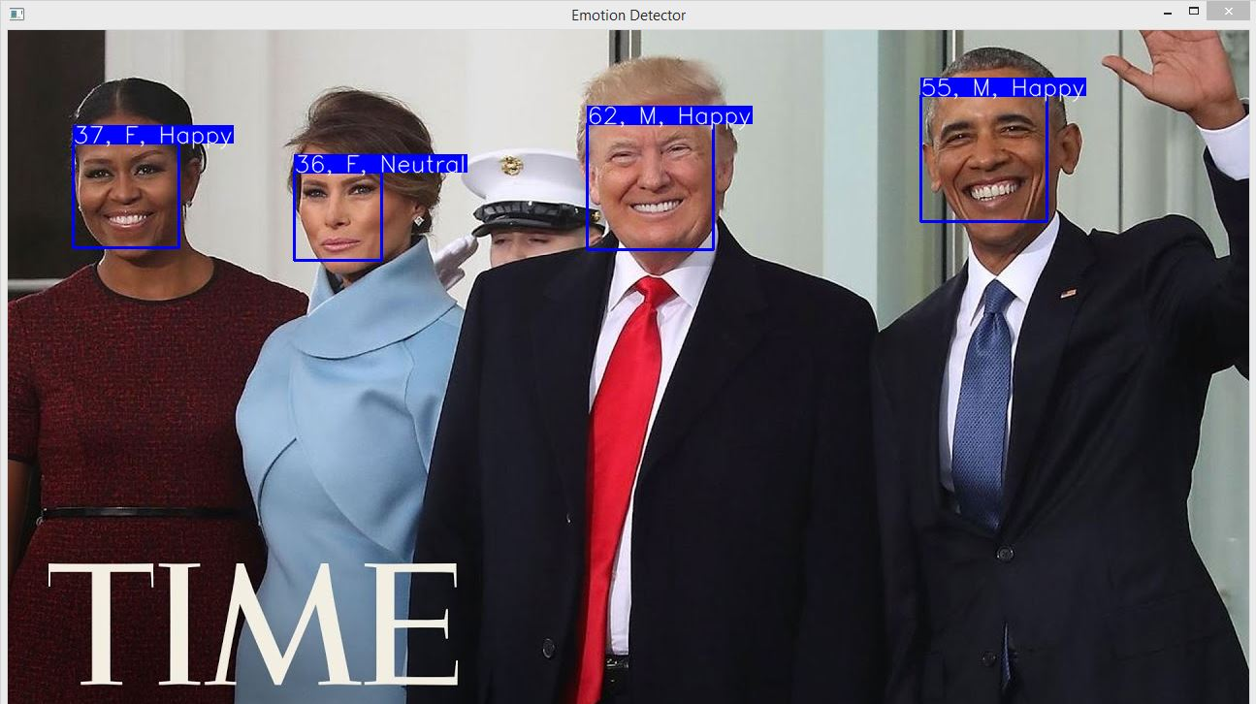
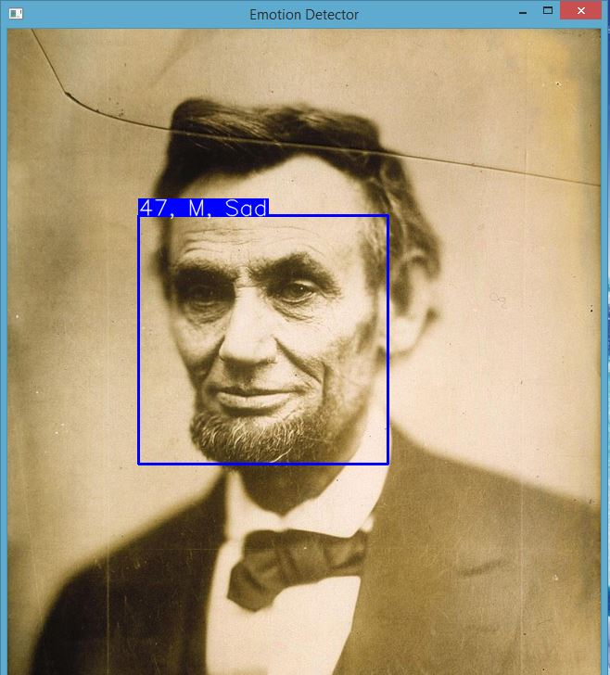
SCREENSHOTS
In this picture, an input is taken as video and a single image person is taken as an video input. The input is then compared with the trained model and face, emotion and gender estimation is done in real time.
The above image is same as the previous image, but this image consists of multiple persons and it captures input from all the people who are in the video and also it detects their age, gender and emotion in real time.

Slide 22
REFERENCES
[1] Pradnya Kedari; Mihir Kapile; Divya Kadole; Sagar Jaikar, "Face Emotion Detection Using Deep Learning", 2nd International Conference On Advances In Computing, Communication, Embedded And Secure Systems (ACCESS), September 2021
[2] Shan Li; Weihong Deng, "Deep Facial Expression Recognition: A Survey", IEEE Transactions on Affective Computing, March 2020 [3] Ji-Hae Kim; Byung-gyu Kim; Partha Pratim Roy; Da-mi Jeong, "Efficient Facial Expression Recognition Algorithm Based on Hierarchical Deep Neural Network Structure", Department of IT Engineering, Sookmyung Women's University, Seoul, South Korea, March 2019. [4] Catherine Marechal; Dariusz Mikołajewski; Krzysztof Tyburek; Piotr Prokopowicz; Lamine Bougueroua; Corinne Ancourt; Katarzyna Węgrzyn-Wolska, "Survey on Al Based Multimodal Methods for Emotion Detection", High-Performance Modeling and Simulation for Big Data Applications, March 2019 [5] Wafa Mellouk; Wahida Handouzi, "Facial emotion recognition using deep learning: review and insights", The 2nd International Workshop on the Future of Internet of Everything (FloE), Belgium, Aug 2020

Slide 23
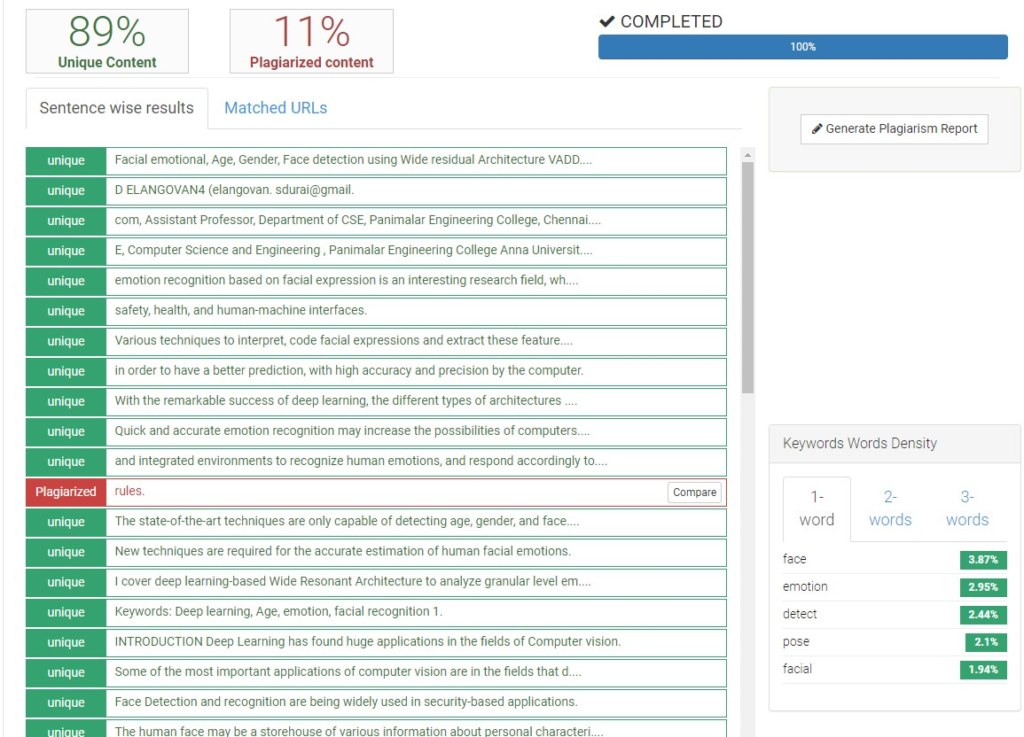
PLAGIARISM REPORT

